Slide 1

Wireless Power Transfer
C1C Henry
C1C Hermanson
C1C Pak
C1C Singh
1

Slide 2
Overview
Executive Summary
Technical Discussion - NSTR
Motivation - NSTR
Problem Statement - NSTR
Related Work - NSTR
Methodology
Results
Discussion
Future Work
Questions?

Slide 3
Executive Summary
During this presentation, we will discuss our action items researched and completed throughout this sprint. We will review significant developments and existing challenges related to our research. Lastly, we will consider the next phase of our research and look ahead at long-term goals of this capstone project.
What WPT is, and the vulnerabilities associated with it. We will also discuss our progress experimenting with its exploitation and what we plan on doing with that information. Finally, we will consider the long-term implications of this capstone project.

Slide 4
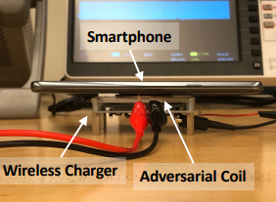
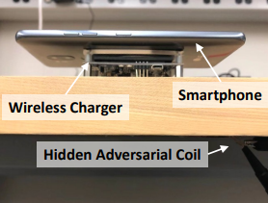
WPT Attack Vectors - Review
Hijacking
Injection of adversarial magnetic signals on the power transmitter to hijack the communication channel
Disruption of magnetic field (via well crafted injection) between transmitter and receiver – cause inefficient power transfer
Control of power transfer process
Eavesdropping
Qi has lack of encryption and authentication mechanisms
Snoop communication between transmitter and receiver
Infer activity of receiver device
Q ID & C allows basic device identification

Slide 5
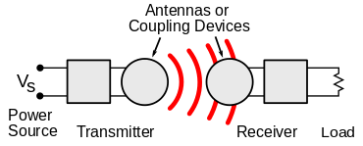
Technical Discussion
WPT is wireless point to point transmission of electrical energy
Many implementations but Qi is the industry standard
Alternatives: AirFuel, Proprietary Near Field Magnetic Coupling, RF, Ultrasound
Delivers a variable amount of voltage to device depending on power requirements
New technology that lacks security capabilities and has vulnerabilities
Malicious messages can be sent between transmitter and receiver to alter power transmission
Messages between transmitter and receiver can be observed to gain information about receiver

Slide 6
Motivation
Wireless Power Transfer could become a common function of new technology
Personal Electronics, Healthcare Devices, Electric Vehicles
Exploit techniques and results found in this experiment can potentially be generalized
This research will create a foundation for further experimentation and TTP development
Findings can be expanded to other wireless non-networked point-to-point connections

Slide 7
Problem Statement
IDENTIFY
What vulnerabilities exist within systems via wireless power transfer; how can these vulnerabilities be exploited and defended against?
APPLY
The initial phase of this research includes the reproduction and expansion of research related to injection based hijacking of the charging process and non-intrusive eavesdropping of the charging process allowing for interpreted analysis of device activity.
EXPAND
This serves as the initial point of research to be provided to the National Reconnaissance Office (NRO) and help observe various other methods of similar side-channel attacks such as taking advantage of point-to-point communication capabilities.

Slide 8
Methodology - Demodulation
MatLab
Strategy: Read waveform data into MatLab and use premade code for demodulation filters
Problems: Familiarity with tool, getting data into Simulink
Oscilliscope Filters
Strategy: Use filters directly on oscilloscope
Problems: No license for bus features
TekScope
Strategy: Use filters within TekScope suite to demodulate oscilloscope signal;
Problems: Doesn’t have a bus for Qi demodulation

Slide 9
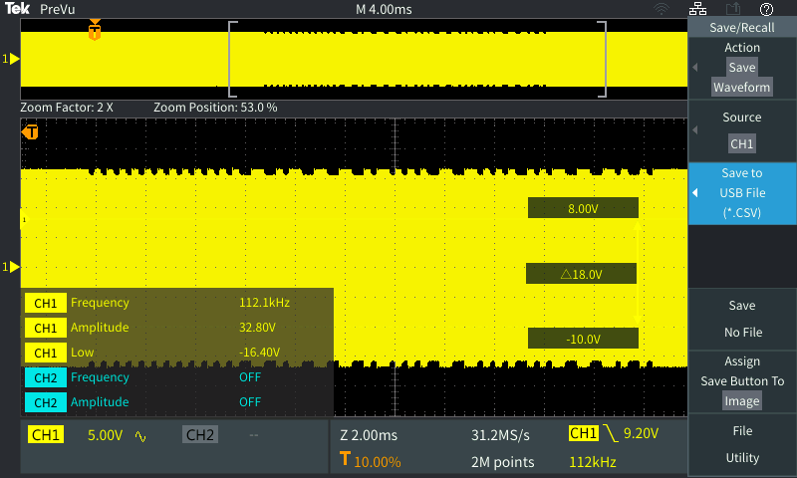
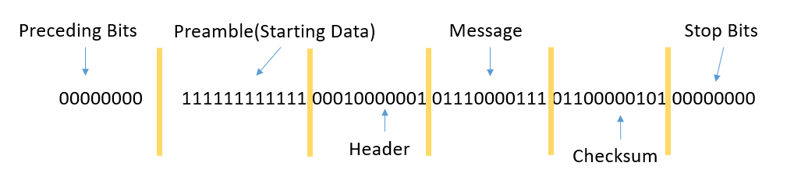
Packet Interception
Captured Signal
Captured Signal Demodulated
Signal Strength Status Update 1

Slide 10
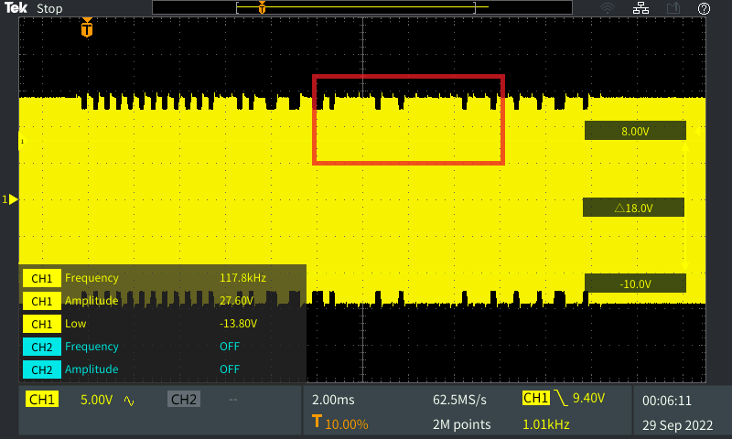
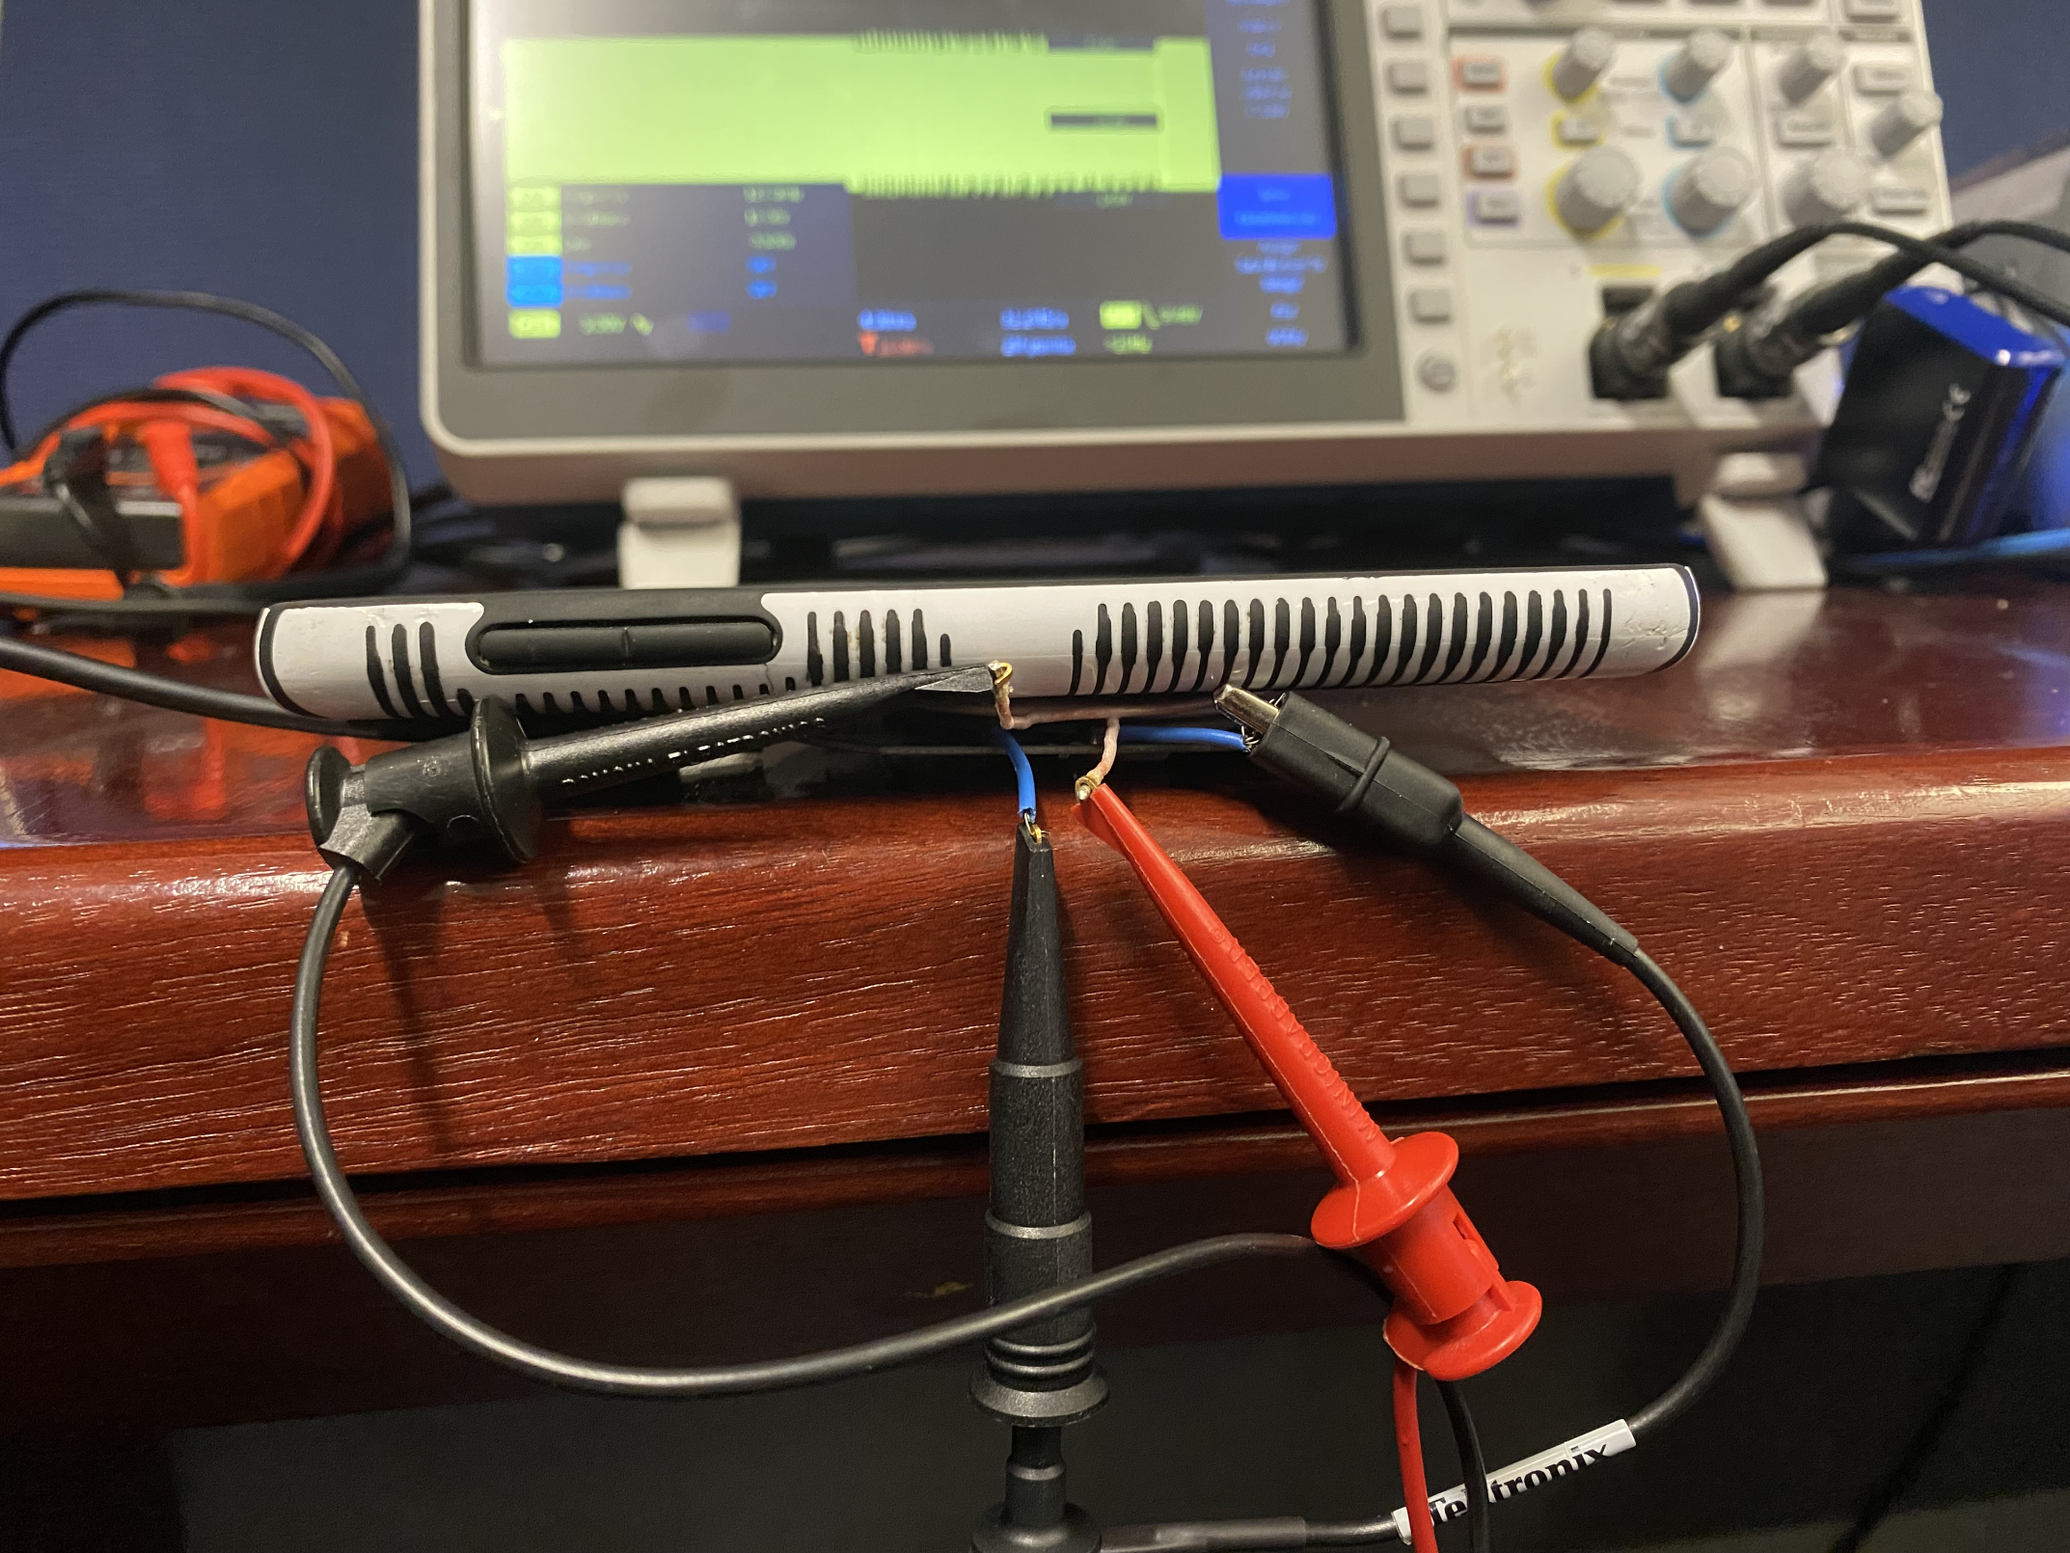
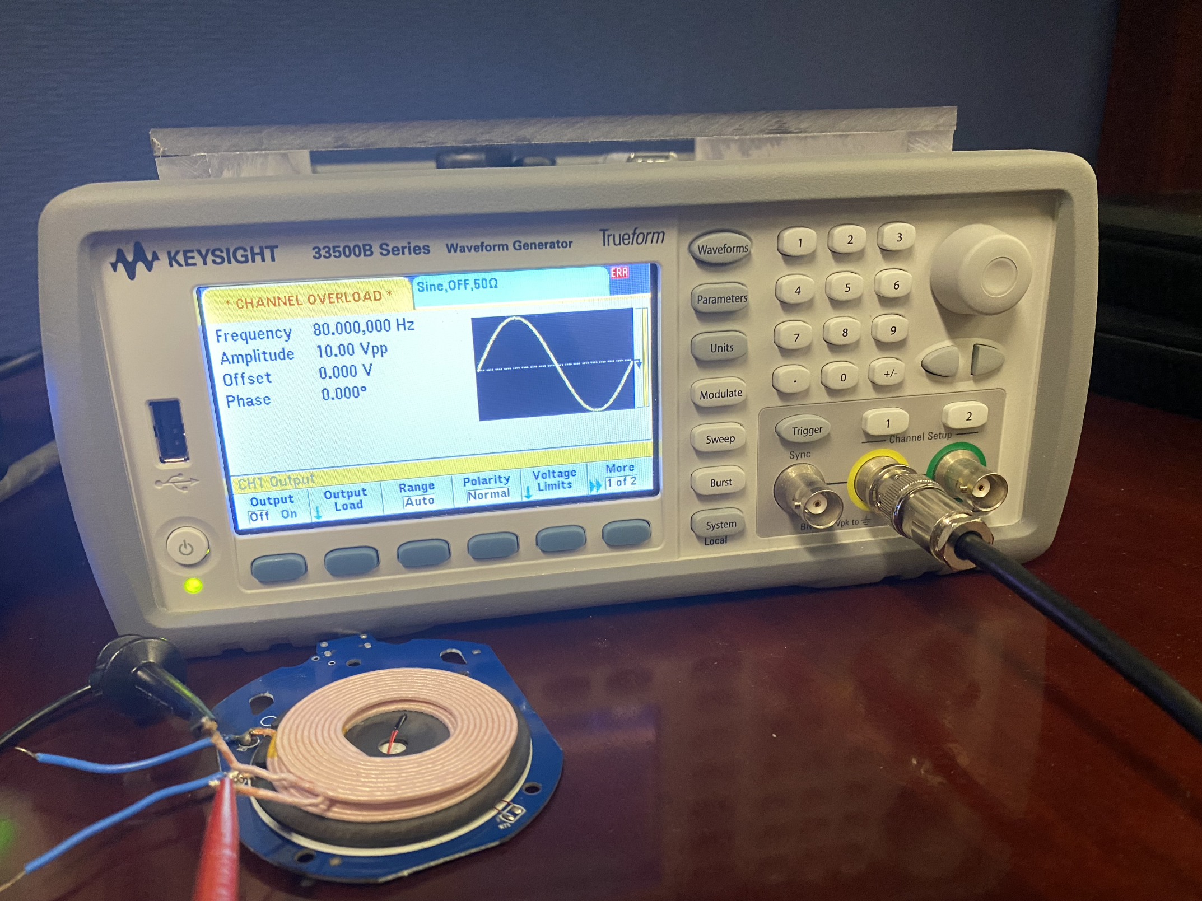
Packet Injection
Crafted Waveform Signal
Frequency: 80kHz
Amplitude: 10Vpp
Offset: 0V
Phase: 0V
Injection Test 1
1 1 1 1 1 1 1 1 1 1 1 1 0 1 1 1 0 1 0 1 0 1 1 1 0 1 0 1 0 1 0 1 1 1 0 1 1 1 0 1 0 1 0 1 1
Channel Overload
(Magnetic Signal Interference)

Slide 11
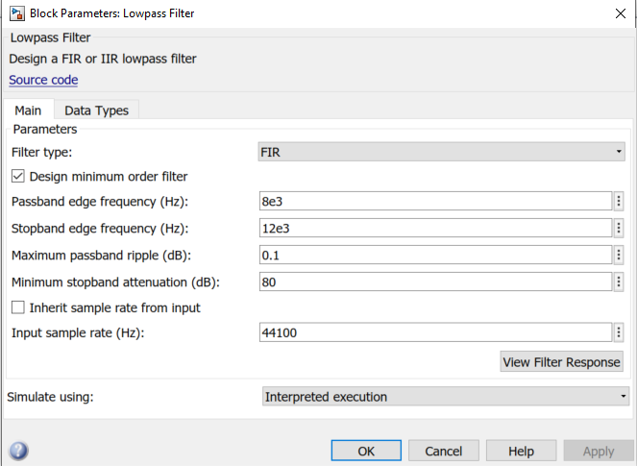
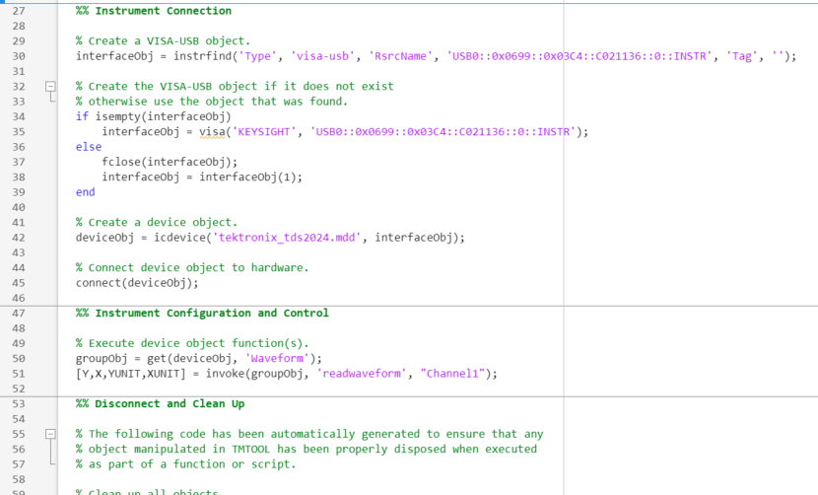
MatLab Demodulation
MATLAB object driver to read waveform/import data
Simulink to apply lowpass filter

Slide 12
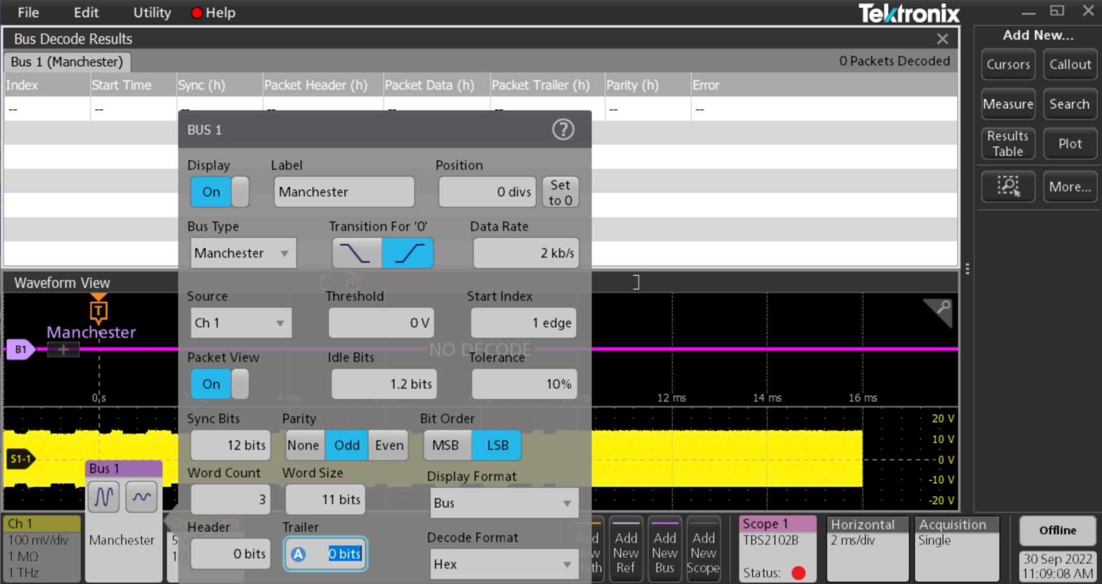
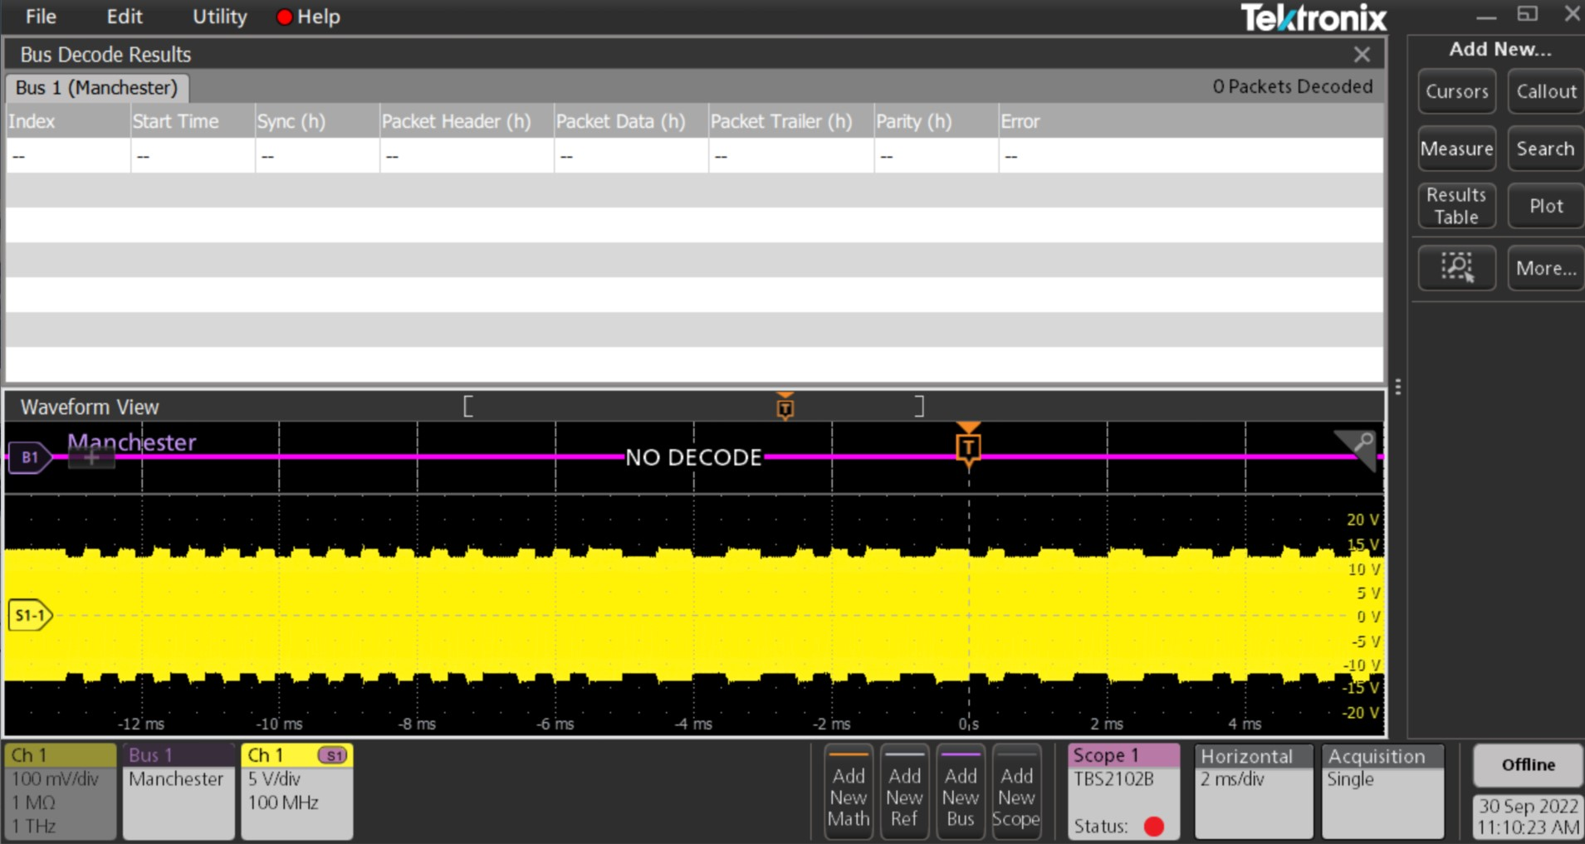
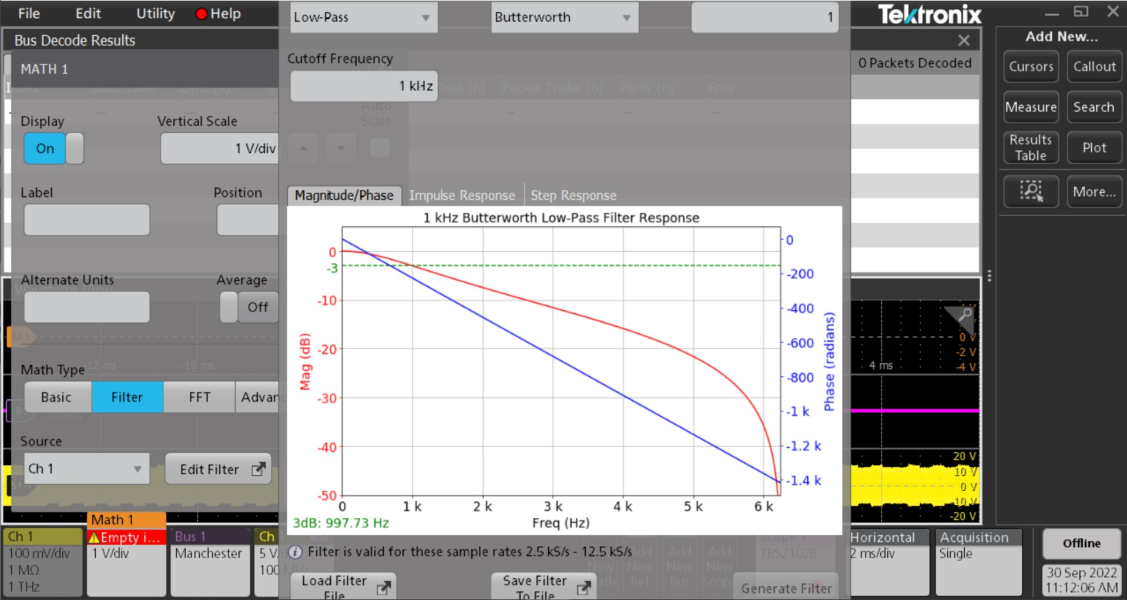
TekScope Demodulation
TekScope software use:
Manchester Bus
Low pass filter
A lot of other attempts
Filters
Busses
Math

Slide 13
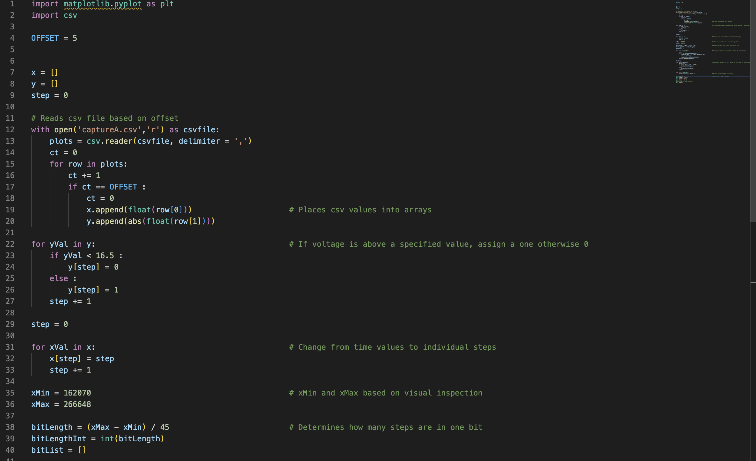
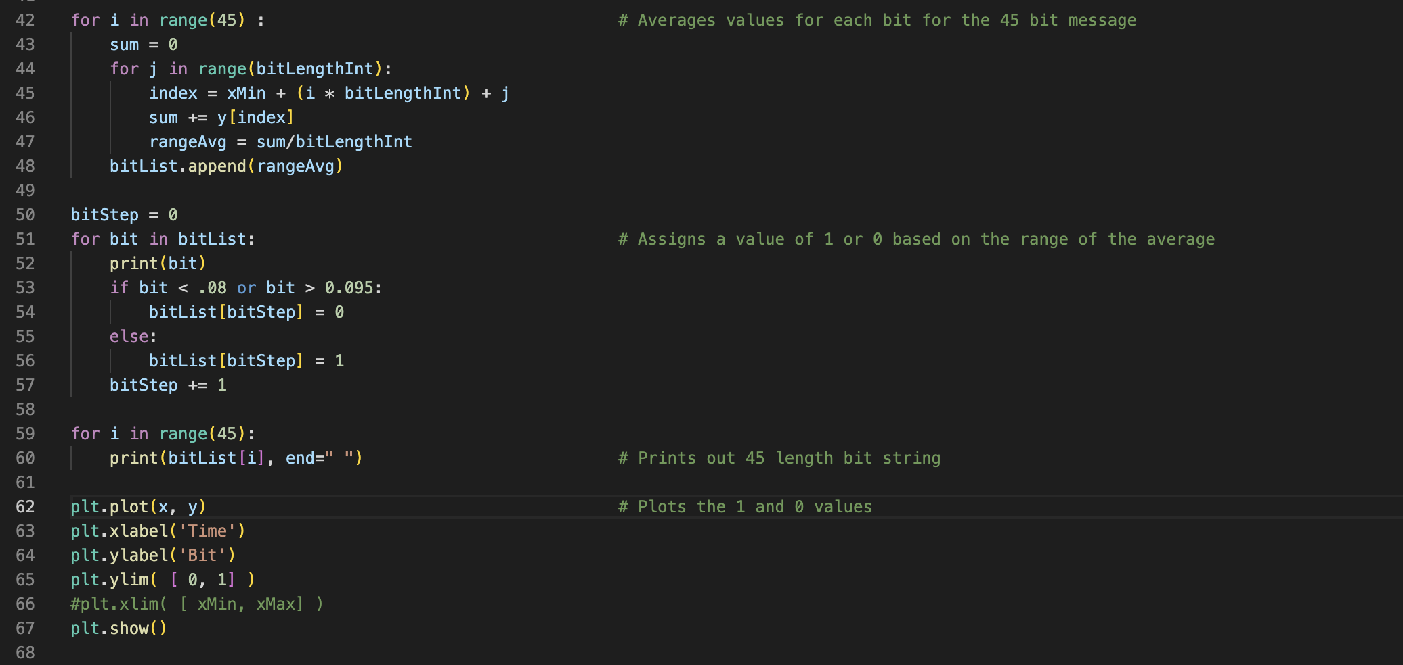
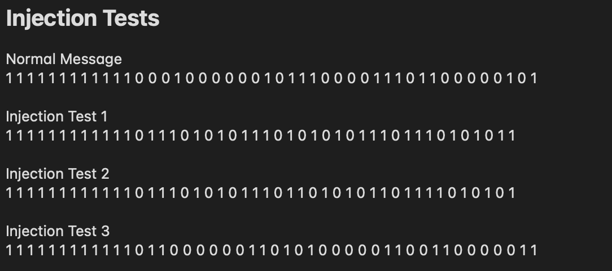
Python Demodulation

Slide 14
Results
Produced Packet Interception and Decoding for Snooping Purposes
Produced Packet Injection with Adversary Binary
Applied Filter Mechanisms to Captured Signal (MATLAB, TekScope)
Developed Packet Demodulation Program

Slide 15
Discussion
Observed phone interacting with charger
Achieved baseline knowledge of tools
Limiting factors
Lack of equipment
Limited knowledge on how to use tools
Difficulty with oscilloscope
Our data doesn't match reading data
Problems applying filters
Challenge in demodulating captured signal to observe Qi data communications

Slide 16
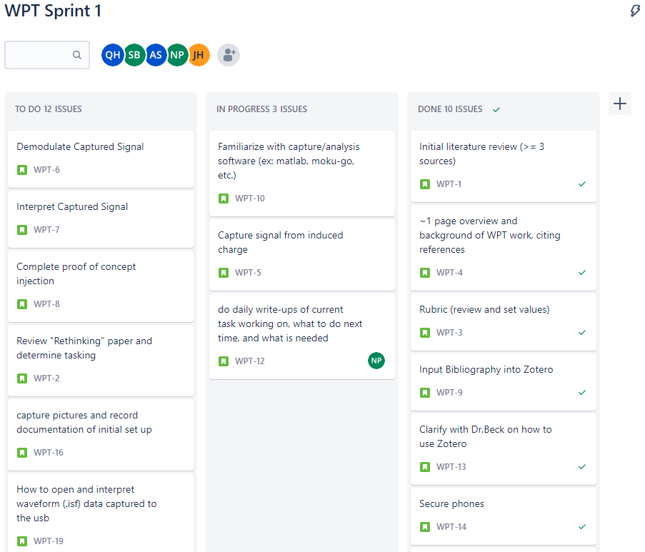
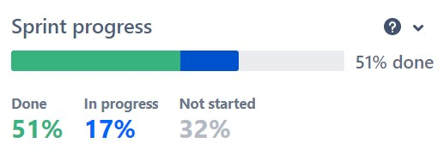
Sprint Organization
Utilized Jira Software to track the sprint process

Slide 17
Sprint 3 Taskers and COAs
Packet Sniffer Acquired
Expand Snooping Research
Differentiate applications – based on power usage
Extract data from communications
Extract user input from receiver
Further Replication of Research
Replicate further aspects of guiding experiment
Hijacking, Data extrapolation,
Injection Development
Craft Hardware
Develop Signal
Experiment with timing
Begin Side Channel Discover Experimentation
Further Research

Slide 18
Future Work
Modification of Qi packets
Qi communication packets are interpreted on the receiver device, modification of the data component within the Negotiation Phase may allow code execution or data exfiltration on the receiver device
Applications with laser-based point-to-point communication
Development of Qi Protection Mechanisms
Hardware or Software based cryptography
Injection/packet modification detection

Slide 19
Questions?

Slide 20

20

